Slide 1
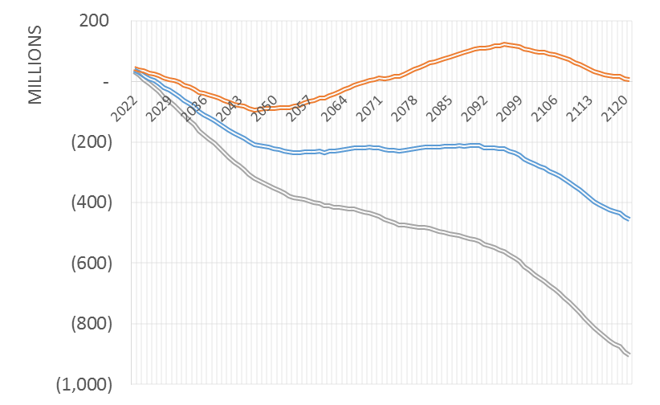
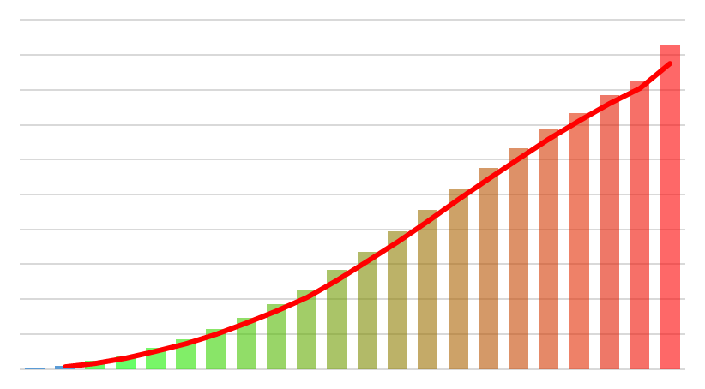
Long Term Financial Planning
Asset Management

Slide 2
Territorial Acknowledgment
AMBC acknowledges that this conference is situated on the unceded traditional territories of the xʷməθkʷəy̓əm (Musqueam), Sḵwx̱wú7mesh (Squamish), səlilwətaɬ (Tsleil-Waututh), and scəw̓ aθən məsteyəxʷ 1 (Tsawwassen) Nations.

Slide 3
Purpose of Course
Empower organizations to quickly analyze funding levels
Promote long-term view in financial planning
Strengthen the role of long term financial planning in asset management
Empower non-financial professions to challenge their Finance peers

Slide 4
Potential for Future Improvement
Make this course more relevant for Regional Districts
Make this course more relevant for First Nations
Integrate more exercises, opportunities to share experiences
Natural assets

Slide 5
Module 1:
Introduction

Slide 6
Duty of Stewardship
“The purposes of a municipality include…(c) providing for the stewardship of the public assets of its community” – Community Charter Section 7

Slide 7
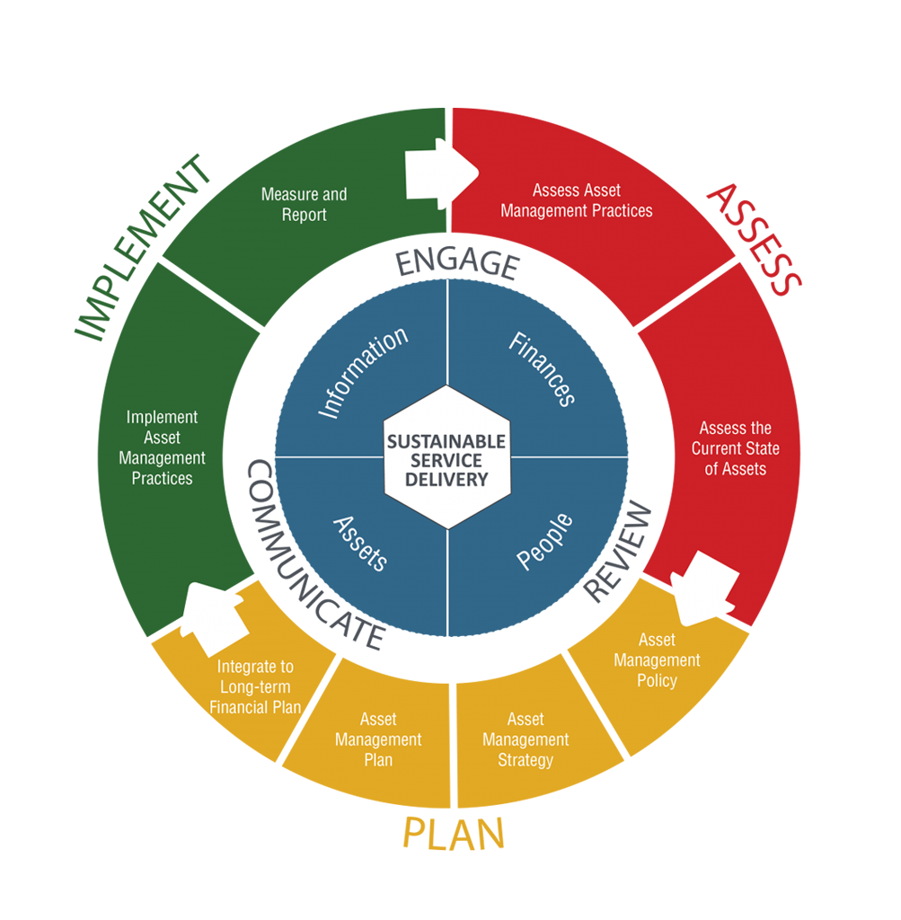
What do we mean by LTFP

Slide 8
Standard for Long Term Financial Planning
AMBC Framework recommends 10-year length minimum
International Infrastructure Financial Management Manual recommends 10-year length
A 10 year plan inadequately anticipates periods of concentrated renewal costs
Average Useful Life of Municipal asset > 70 years
Spending ≠ Funding

Slide 9
Imperfection Principal
Variables required to estimate spending are difficult to predict:
  Replacement costs/inflation
  Debt interest
  Investment returns
  Technological improvements/service level changes
Much more can be lost to inaction than imperfection

Slide 10
Sustainable Funding – What is it?
Funding that is spread across the life of an asset
Users pay as their assets are consumed
Intergenerationally equitable

Slide 11
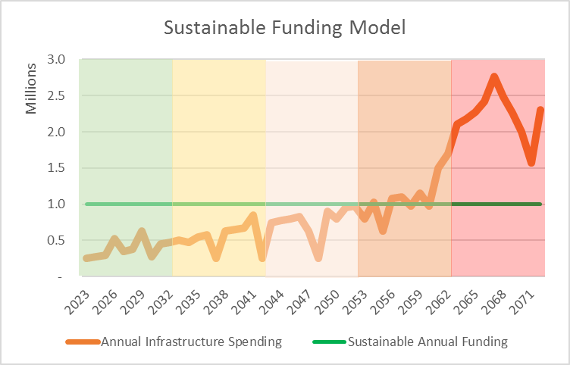
Years 1-10 Average | $390k
Years 11-20 Average | $540k
Years 21-30 Average | $765k
Years 31-40 Average | $1,092k
Years 41-50 Average | $2,230k
50-year Sustainable | $1,004k

Slide 12
Sustainable Funding Equity Demonstration
Assume:
Fire truck replacement cost: $1M
Useful life = 10 years
Annual Sustainable funding = $1M/10 = $100,000
Assume Annual unsustainable funding = $40,000
Annual Funding Gap = $60,000 ($100k - $40k)

Slide 13
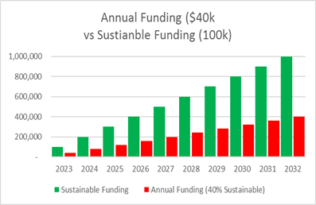
Sustainable Funding Equity Demonstration
Funding shortfall = $600,000 ($1M cost of fire truck less $400,000 saved)

Slide 14
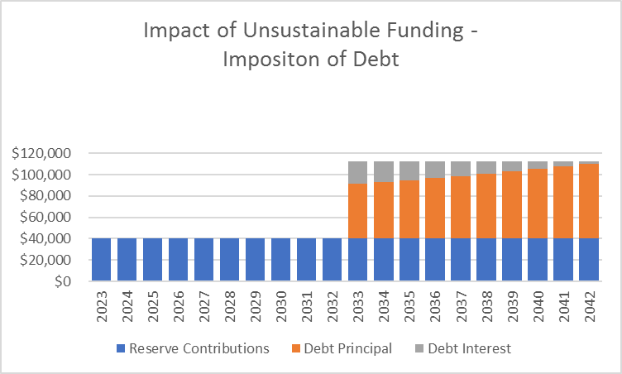
Sustainable Funding Equity Demonstration
Generation 1
Generation 2

Slide 15
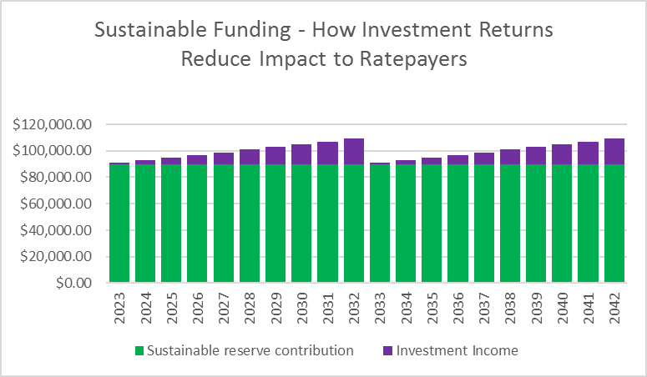
Sustainable Funding Equity Demonstration
Generation 1
Generation 2

Slide 16
Sustainable Funding Equity Demonstration

Slide 17
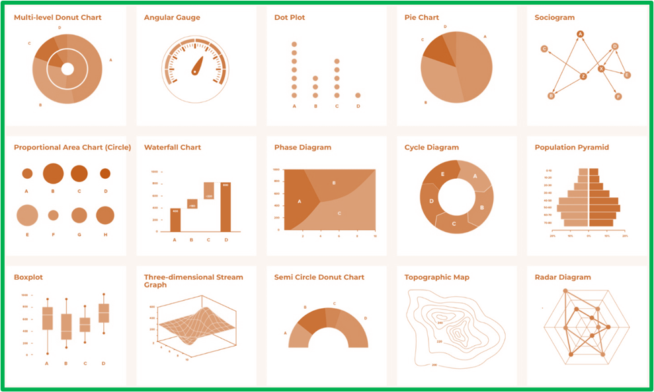
Module 2: DATA COLLECTION

Slide 18
Required Data
Infrastructure Material Type
Infrastructure Size and Location
Infrastructure Costing Information
Infrastructure Estimated Useful Lives
Current Infrastructure Funding Levels
Condition Assessments

Slide 19
Criticality of Data

Slide 20
Required Data
Have a look at Appendix A
Look at Asset Inventory

Slide 21
Required Data
Infrastructure Material
Infrastructure Size & Location
Infrastructure Construction/In-Service Dates
Costing Information
Estimated Useful Lives
Funding Levels
Condition Assessments

Slide 22
Data Sources
Conditions Assessments
  Facilities Condition Assessments
  Pavement Condition Assessments
  CCTV Storm/Sewer
  Playground Inspection Reports
  Bridge Inspection Reports
Costing Information

Slide 23
Data Sources
Debt Amortization Schedules
Graphic Information System export
Investment performance (historical)
Tangible Capital Asset Register

Slide 24
Data Sources
Master Plans
  Water
  Sanitary Sewer
  Storm Sewer
  Parks and Playgrounds
  Transportation
  Sidewalk/Pedestrian
  Urban Forest

Slide 25
Data Sources
Policies/Bylaws
  Asset Management Policy
  Financial Plan Bylaw
  Investment Policy
  Purchasing Policy
  Official Community Plan
  Tangible Capital Asset Policy
  Tax & Utility Rate Bylaws

Slide 26

Module 3: CORE CALCULATIONS

Slide 27
Replacements Costs
Capital Project Cost Classification:

Slide 28
Replacement Costs
Linear: unit rate x length
  Storm, sanitary sewer, water, curb & gutter
Area: unit rate x area
  Roads, sidewalk, buildings
Buildings
  Appraisal by building or
Park structures: varies

Slide 29
Sustainable Annual Funding - Simplified
Asset Replacement Cost / Useful Life
  Doesn’t take investment returns into consideration
  Appropriate for LGs who are way behind in funding and assets are well-consumed
Review Exercise 1 – fill out column G

Slide 30
Sustainable Annual Funding - Complex

Slide 31
Sustainable Annual Funding - Complex

Slide 32
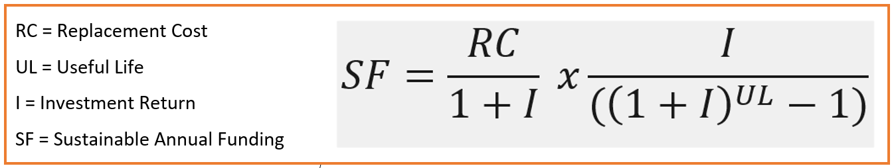
Determining Sustainable Funding Levels
Annuity Method includes the impact of investment returns:

Slide 33
Why is Sustainable Funding so Powerful?
Method | Annual Contribution Required | Comment
Simplified Sustainable Method | $1,250 | Replacement cost ($100,000) divided by Useful Life (80 years) – no investment interest
Annuity Method (Includes Investment Returns) | $506 | Assuming 2% investment return compounded annually over full 80 year planning period
Debt Funded | $1,433 | Over a 30 year amortization, which is maximum borrowing permitted in LGA and CC, it would be $4,788 (2.5% assumed interest rate and actuarial capitalization rate)

Slide 34
Sustainable Annual Funding – Componentized assets
What is meant by componentized assets?
  Some assets are composed of major components
  These components have long useful lives that are shorter than the entire asset
  E.g. Buildings and Roads
Lifecycle capital costs exceed total value of asset

Slide 35
Sustainable Annual Funding – Componentized assets

Slide 36
Sustainable Annual Funding – Componentized assets
Exercise 3
Step 1: Assign component replacement values
Step 2: Assign component useful lives
Step 3: Determine intra lifecycle component replacements
Step 4: Multiply 2 by 3 to determine total lifecycle costs

Slide 37
Sustainable Annual Funding
What about inflation?
  Once you achieve sustainable annual funding – annual increases equal to cost escalation
  Just like any other “forced growth factor”
  Inflation can be hedged with a good investment strategy so long as sustainable funding is in place

Slide 38
Funding Levels Calculation
Open Financial Plan Example determine current funding levels

Slide 39
Funding Levels Calculation – Apportionment
Open Asset Inventory ‘Current Funding’ tab
How do you apportion undedicated reserves such as general infrastructure replacement reserve
  Could on the basis of asset inventory proportion
  Could on the basis of forecasted expenditures
  Could on the basis of weighted consumption
  Could on the basis of professional judgement

Slide 40
Annual Funding Gap
Sustainable annual funding less actual annual funding
This measure is important because your primary funding objective will be to close this gap

Slide 41
Asset Consumption
Age/Useful Life
Will want to summarize by each asset class
  E.g. “water infrastructure is 53% consumed on average”

Slide 42
Accumulated Infr. Funding Gap
Value of Consumption less actual reserves

Slide 43
Accumulated Infr. Funding Gap

Slide 44
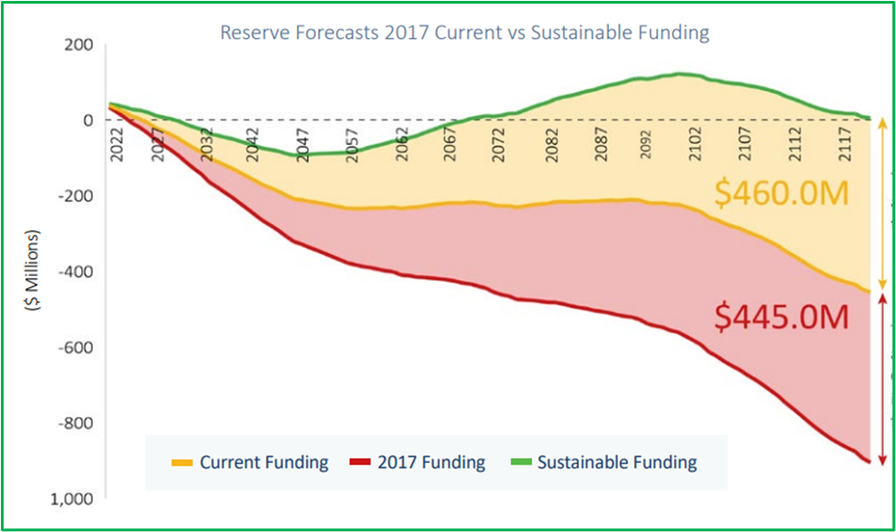
Module 4: MODELLING

Slide 45
Spending Forecasts
100-Year spending forecasts are helpful painting a picture of order of magnitude
Spending forecasts along with reserve contribution forecasts demonstrate long-term funding gap
Can demonstrate periods of concentrated infrastructure replacement

Slide 46
Spending Forecasts

Slide 47
Reserve Forecasts
Preparing reserve forecasts demonstrate if current or proposed reserve contributions cover forecasted 100-year spending
Failure to cover 100-year spending will result in negative reserve forecast

Slide 48
Reserve Forecasts

Slide 49
Reserve Forecasts
Exercise 4

Slide 50
Investment Returns & Debt Interest
Reserve forecasts should include investment returns earned on reserve balances or debt interest needed for funding shortfalls
Investment returns earned in reserves must be used in reserve fund
MFA has indicative indexes for both

Slide 51
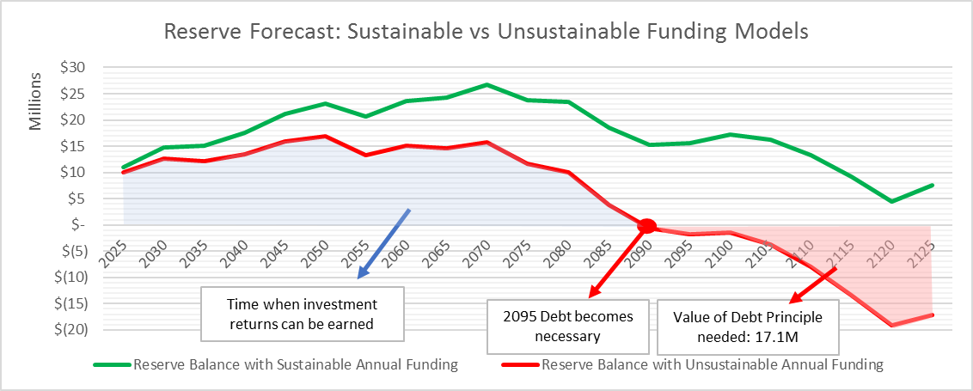
Investment Returns & Debt Interest

Slide 52
Investment Returns & Debt Interest
  Demonstrate MFA Debt Amortization Tool

Slide 53
100-Year Funding Gap
Two ways of calculating:
  (Sustainable annual funding – current annual funding) x 100
  Total forecasted reserve balance 100 years from now using sustainable reserve contributions LESS total forecasted reserve balance 100 years from now using current reserve contributions

Slide 54
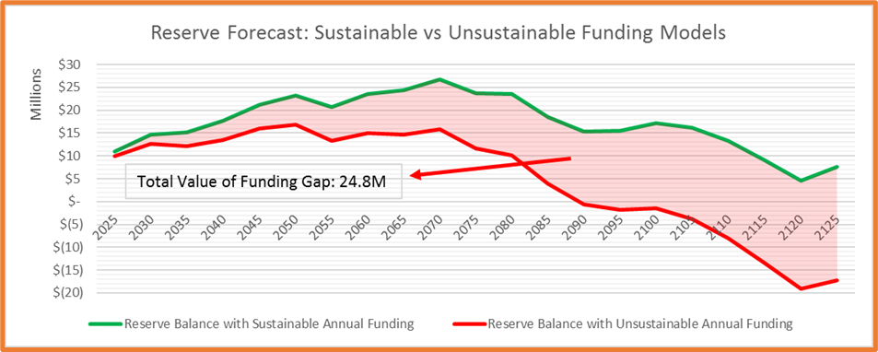
100-Year Funding Gap

Slide 55
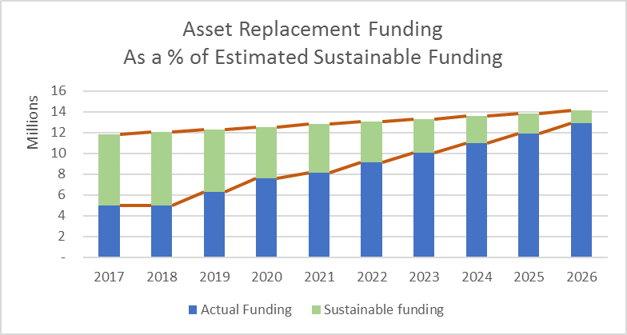
Module 5: FUNDING OPTIONS

Slide 56
Developing Funding Options
Should be developed by utility and according to Organization’s user fee policy
  Does your organization fund all water expenditures through a water utility? Or partially tax funded?
  Needs to include investment returns earned within utility
  Look at exercise 5

Slide 57
Non-Market Change Revenue
+$
+$$
+$$$
Rezoning
Subdivision
Building Permit
Capital Maintenance
Infrastructure Replacement
New Ops Costs
-$
-$$
-$$$

Slide 58
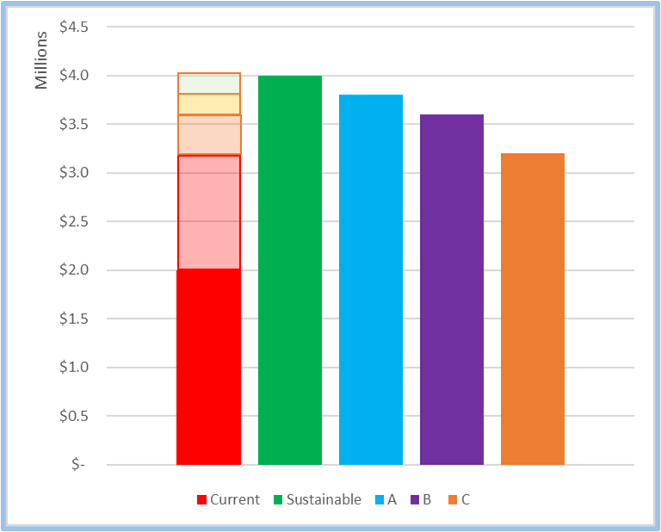
Module 5: SENSITIVITY ANALYSIS

Slide 59
Broad Finding Validation
  Useful lives and replacement costs will always be able to be disputed
  The fact that there is a significant funding gap is normally not disputable if a good sensitivity analysis has been complete
  Optimistic forecasts would increase useful lives and decrease unit costs
  Pessimistic forecasts would decrease useful lives and increase unit costs

Slide 60
Other variables
  Investment returns
  Debt interest
  [demonstrate sensitivity programming in Asset Inventory spreadsheet]

Slide 61
Other variables
 | Scenario B | Scenario C | Scenario D | Scenario E | Scenario F
Sanitary Sewer Pipe Useful Life | +25% NAMS | NAMS | NAMS | -10% NAMS | -25% NAMS
Watermain Pipe Useful Life | +25% NAMS | NAMS | NAMS | -10% NAMS | -25% NAMS
Investment Return % (average) | 3.5% | 3.5% | 3.5% | 3.0% | 2.5%
Debt Interest % (average) | 2.5% | 2.5% | 3.0% | 3.5% | 3.5%
Unit Rates | -10% | -10% | n/a | +10% | +20%
Annual Sustainable Funding | $9.1M | $10.6M | $11.9M | $12.6M | $13.2M
Annual Funding Gap $ | $2.5M | $4.0M | $5.3M | $6.0M | $6.6M
Annual Funding Gap % | 27.4% | 37.8% | 44.5% | 47.6% | 50.0%
% Sustainable Funding | 72.5% | 62.3% | 55.5% | 52.4% | 50.0%
Cumulative Infrastructure Funding Gap | $186.7M | $205.2M | $234.7M | $258.1M | $299.1M
$ Infrastructure overdue for replacement | $0.5M | $20.6M | $45.3M | $50.3M | $55.3M
% Infrastructure overdue for replacement | 0.0% | 4.1% | 9.1% | 10.1% | 11.1%

Slide 62
Module 7: COMMUNICATING FINDINGS

Slide 63
Communicating Findings
An AM Plan is not effective if findings are not articulated well to governance
Communications Plan
PR Plan
  Social media plan
  Video
  Press Release
  Governance Briefing

Slide 64
Communicating Findings
Professional Report
  Executive Summary
  Intuitive Visuals
  Logically laid out
  Key Terminology and phrasing
  Branding
  Professional proof read

Slide 65
Executive Summary
Introduction
Purpose of Plan
Key Findings
  Inventory valuation
  Infrastructure Condition
  Annual funding vs sustainable
  Sensitivity analysis findings
  Accumulated Funding Gap

Slide 66
Executive Summary
Key Recommendations
  Funding increase recommendations
  Policy Recommendations
    Procurement
    Land-Use
    Debt Management
    Investment
    Budget
    Non-market change

