Slide 7
Asset management
Notes:
Welcome…thank you for coming out. Over the past several years we have heard a lot about asset management. Some of it has been obvious, some of it has been useful and a great deal of it has been confusing. Today is all about clarity. Our hope for today is that everyone will leave knowing what asset management is, why it matters and what value it brings to the table. Also, what our role is as elected officials, what the role of staff is and how these roles necessarily fit together. And finally, but most importantly, how we can get started right now!

Slide 8
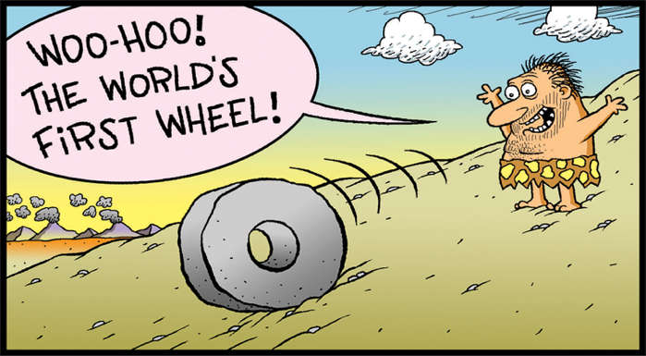
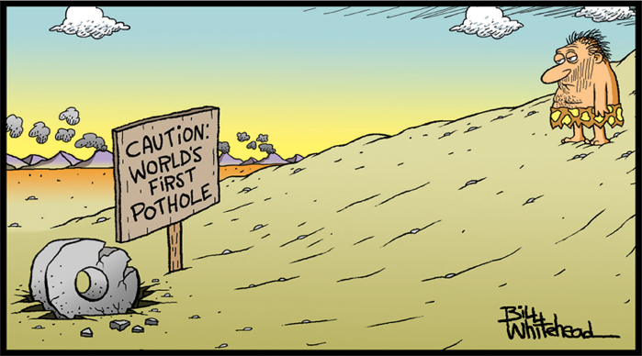
1
PART
What is asset management?
Notes:
Notes: Let’s start by exploring what is asset management?

Slide 9
What is an asset?
Assets provide services that contribute to our quality of life
Notes:
Key message: Assets provide our community with services.
Notes: Our community assets are publicly owned. These assets are made up of natural ecosystems (like wetlands and aquifers), the constructed environment (like roads, buildings and playgrounds), and the equipment and resources needed to maintain what we have. So, our water, sewer and drainage systems, our transportation networks, our walking trails, our green spaces, our sports and recreation facilities…they all provide services that our communities rely on. Each of these assets performs a function which provides a service that our residents value and have come to expect as part of their everyday lives.

Slide 10
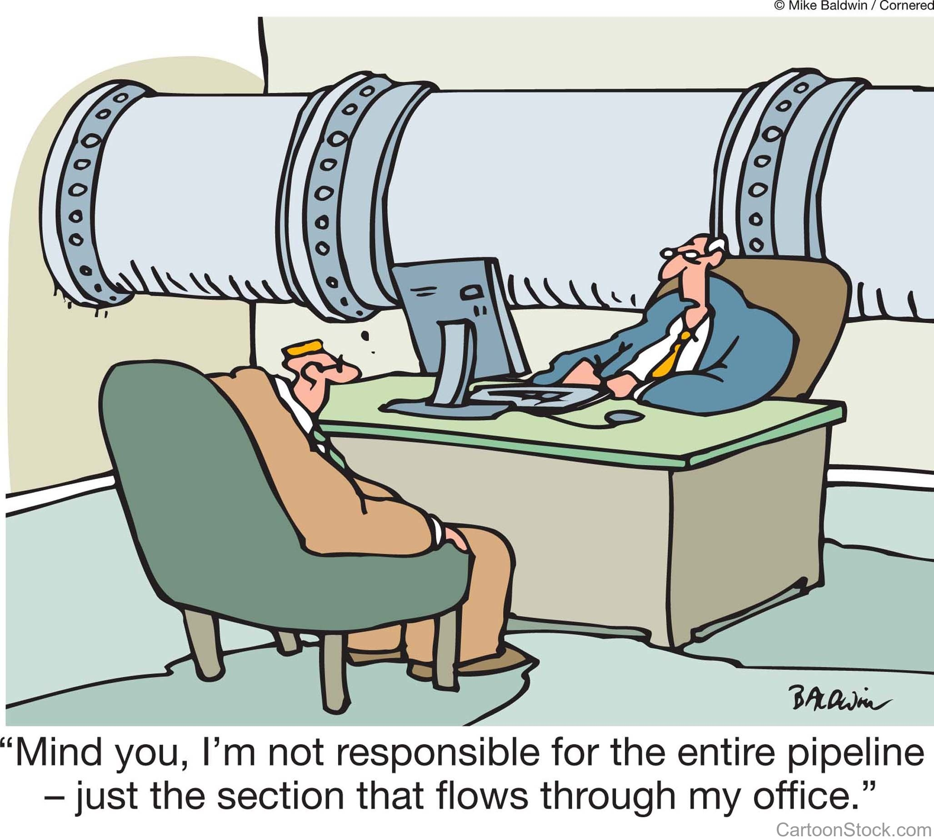
What is management?
Notes:
Key message: Management means to “actively care for” the things we own and are responsible for.
Notes: Management, by definition, means to care for, to be in charge of and to nurture. Management means that we don’t wait for a crisis or a service failure to occur before acting; we minimize and prevent those events through active management and formalized planning. It is about moving from reactive decisions to proactive management.

Slide 11
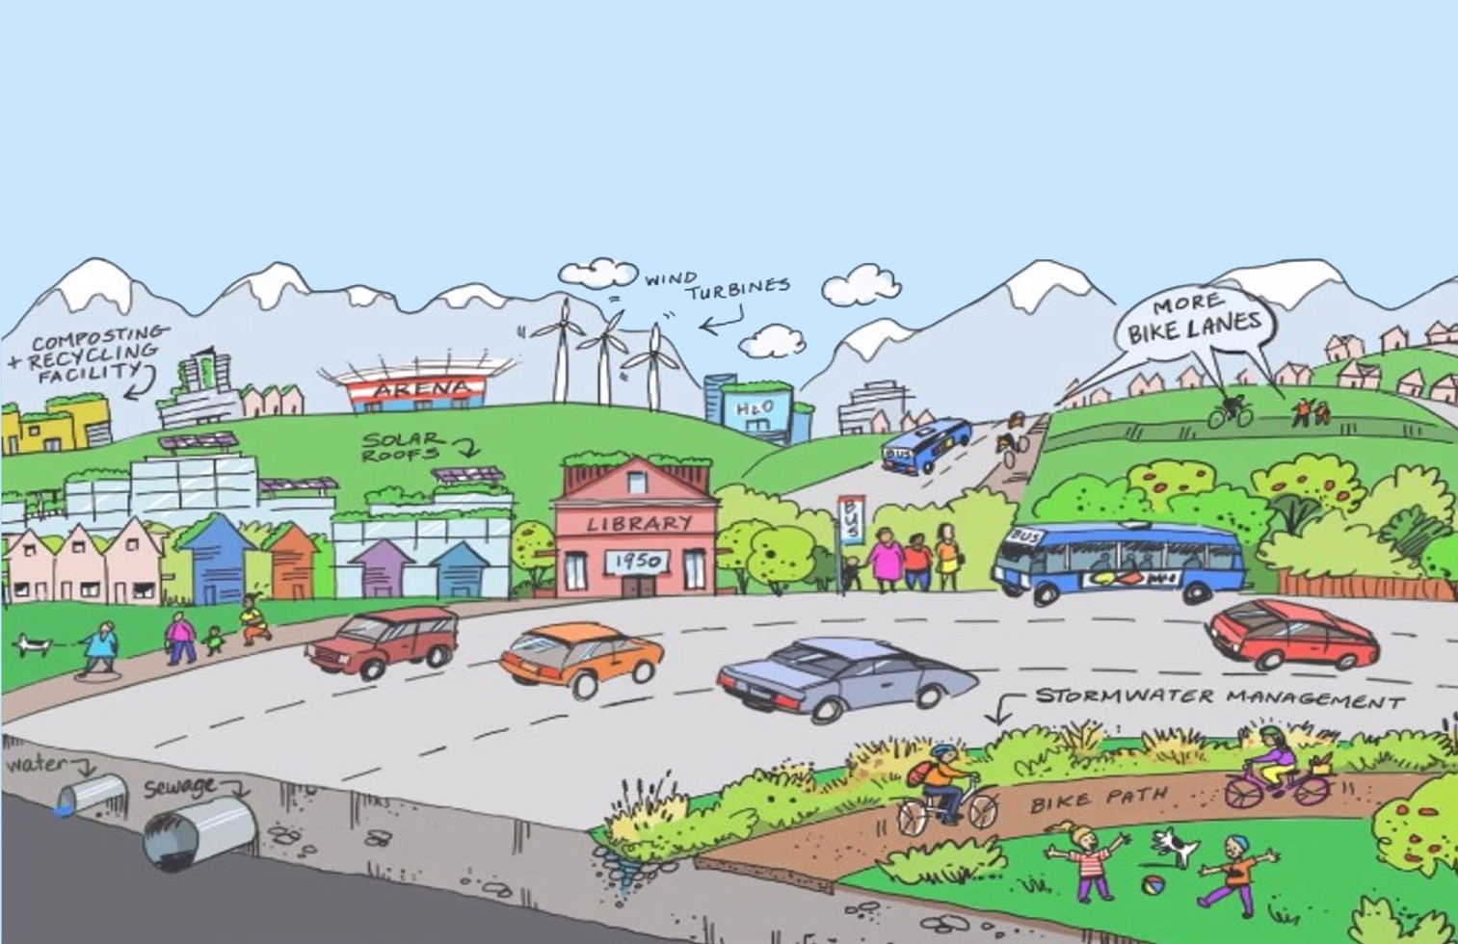
Formalized planning for the services that contribute to our quality of life
Notes:
Key message: Management is an active and ongoing activity that ensures that services are delivered in a seamless fashion.
Notes: Actively managing our assets means paying attention to both what we can and can’t see. It is caring for the visible roads and the hidden pipes. We need to actively manage all assets in a way that ensures they will continue to contribute to the quality of life of our citizens now and in the future.

Slide 12
Asset management is…
What condition is it in?
What do we own?
Where is it?
What needs to be done?
What is it worth?
When does it need to be done by?
Notes:
Key message: Do we have the necessary information—the answers to these questions—to be able to make strategic decisions?
Notes: Asset management helps us put some rigour and structure around the information we use to make strategic decisions. We use it so that our assets will continue to work well, with no surprises, and provide our citizens with services.
Here are the basic asset management questions:
• What do we own? Where is it?
• What condition is it in?
• What is the level of service (current and desired) that each asset provides?
• What is the asset’s remaining useful life or service life?
• Which assets are the most critical, and what is the level of risk to their function and sustainability?
• What do we need to do to sustain the services provided by each asset? When do we need to do it by? What will it cost?
Think about these questions for a moment. As stewards of community assets, how confident are we that we have this information readily available? If we don’t, what would it take to get into a position where we could answer those questions with confidence?

Slide 13
Asset management is a process used in decision-making.
It helps us care for the infrastructure that delivers valuable services to our community, in a way that:
Considers service needs of our community
Manages risks and opportunities
Uses resources wisely
Notes:
Key message: Asset management is a process used in decision-making.
Notes: So, for local governments, engaging in an asset management process allows us to answer the fundamental questions: How do we best care for the assets that deliver services to our residents; the very services that they rely on every day?
And what they truly want is safe and sustainable services delivered in a predictable, cost-effective manner.
In truth, our residents don’t want to have to think about it. They just want it to happen without any unpleasant surprises or inconvenient disruptions. Our job is to manage assets and deliver services in the smoothest and most fiscally responsible manner possible.

Slide 14
Asset management is not…
A plan
Software
Data collection
Notes:
Key message: Asset management combines smaller parts. The parts are not, in and of themselves, asset management.
Notes: As important as it is to understand what asset management is, it is equally important to understand what it is not. There are ingredients that contribute to the recipe, but in the same way that flour is not bread, these things are not asset management.
Although asset management is not a standalone plan, asset management plans, software and data collection can all be useful ingredients that can support holistic and integrated asset management practices.
If you are short on time, you may choose to omit this slide.

Slide 15
Asset management is not just the job of…
Staff
Consultants
It is everyone’s job
Notes:
Key Message: Asset management is a team effort.
Notes: Everyone has a role to play. The role of an elected official is to provide sound governance over the delivery of services that in turn provide our citizens quality of life. Given that council controls the strategic direction and required resources, it is critical that elected officials understand their role in asset management.
If you are short on time, you may choose to omit this slide.

Slide 16
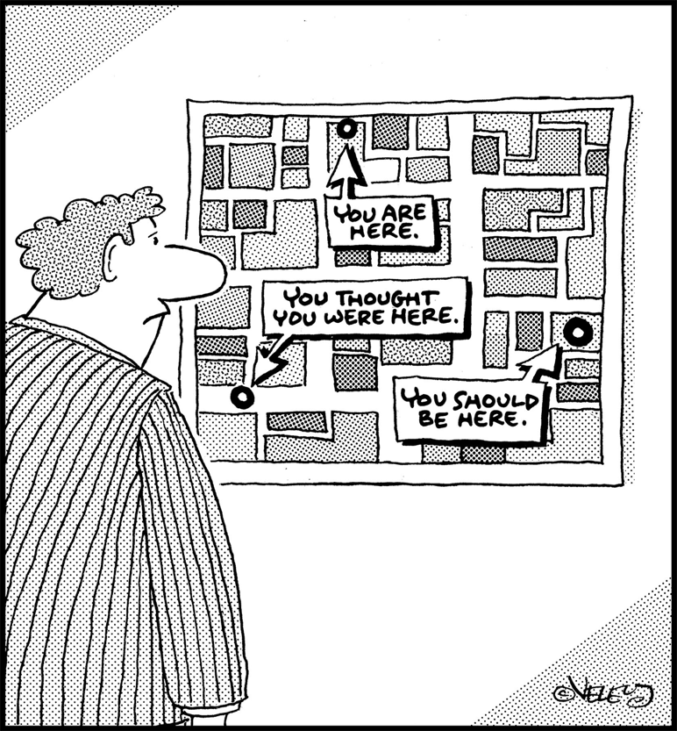
Asset management is…
}‘
A process
A journey
An approach
A way of doing business
Notes:
Key message: Asset management is a long game.
Notes: Asset management is an ONGOING process that leads to safe and sustainable services delivered in a predictable, cost-effective manner. It takes time and effort. An asset management program does not appear overnight and can take years to fully implement—so we need to get started!

Slide 17
Haven’t we been doing this all along?
Notes:
Key message: Asset Management allows us to be intentional with our resources.
Notes: Some of you might be asking: “We do this all the time, don’t we?”
The answer is, in part, “yes,” but not fully. In reality, what we have been doing generally falls somewhere between accidental and intentional: necessarily reactive and, when possible, proactive.
Over time, community needs change and expectations often grow. The costs of our assets and services have increased but our investment in them has not kept pace. Too often it has been, “If it isn’t broke, let’s leave it until tomorrow.” But there are always other areas where our precious budgets are required. When we fail to consider the full cost of things like preventative maintenance, evolving operations and asset renewal, the investment we make in our assets is likely going to be insufficient. And our assets are nearing the end of their useful lifespan faster than we are covering the costs of replacing them. The asset management process acts as a truth serum. It reveals the extent to which we have inadequately invested in the full life cycle costs of our assets.

Slide 18
2
What is the benefit of asset management to my community?
PART
Notes:
Notes:
Let’s think about the benefits that asset management can bring to our community.
What can asset management do to help our community run more effectively?
What problem does it solve?

Slide 19
What do people in our community want?
Safe and sustainable services in a predictable, cost-effective manner.
Notes:
Key message: Our community members want safe and sustainable services delivered in a predictable, cost-effective manner.
Notes: Let’s go back to what our citizens want: safe and sustainable services delivered in a predictable and cost-effective manner. It is all about the service. The asset management process formalizes existing management practices—it gives them some rigour and structure. This gives us sound information. It helps us determine how best to invest in our assets so that our residents can continue to enjoy the services and amenities that contribute to their quality of life, so that they can receive the value of those services without disruption.

Slide 20
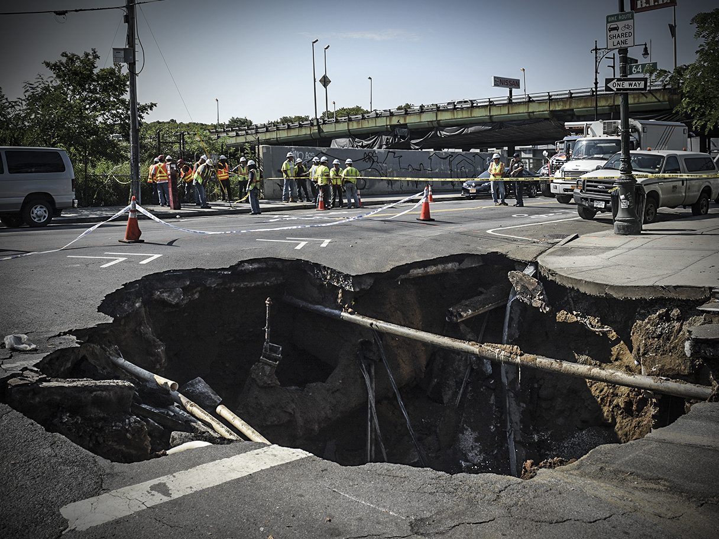
People don’t want surprises like this.
Notes:
Notes:
People get irritated when they experience disruptions or poor-quality services, or when their expectations are not met. Asset management can help us reduce the risk of these unpleasant surprises.

Slide 21
We need a system that helps us to…
Maintain the delivery of services
Plan for the future
Manage risk
Budget smartly
Notes:
Key message: Asset management is a system that can help us achieve our objectives.
Notes: We need a system that lets us plan for the future, manage inherent risk, maintain our assets over their whole lifespan and, fundamentally, invest our limited resources wisely. Asset management is that system.
It is a holistic approach to planning, budgeting and decision-making that is driven by solid information. It is based on expected levels of services and is not subject to the changing gusts of political winds. The asset management process allows us to engage in intentional, rather than reactionary or accidental, oversight of the services we provide.

Slide 22
How does asset management
deliver value to my community?
Performance
Risk
Cost
Value from services
Notes:
Key message: All the components of asset management are important. It is the interplay of performance, risk and cost that leads to value. This is a simplified linear visual of those parts.
Notes: What are the main components of the asset management process? They are performance, risk and cost. This pretty simple formula (when implemented and followed) is what allows us to deliver safe and sustainable services in a predictable and cost-effective manner, giving our residents what they want and need.
This comes back to our definition of asset management. It is a process used in decision-making to help us figure out how we care for the infrastructure that delivers valuable services to our community in a way that:
Considers current and future needs (this is the PERFORMANCE component)
Manages risks and opportunities (this is the RISK component)
Uses resources wisely (this is the COST component)

Slide 23
1
Component Performance
Does it do what it is supposed to at the level we expect?
My road gets plowed within 24 hours of a snowfall, not once a month.
Notes:
Each component of asset management guides us to answer the following questions:
1. Does it do what it is supposed to and at the level we expect?

Slide 24
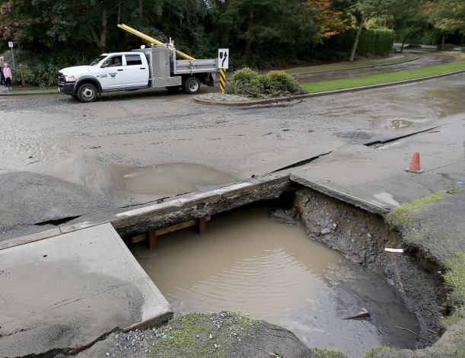
2
Component Risk
What is the likelihood of service failure?
What is the consequence of service failure?
Notes:
2. What are the risks and consequences of this service being disrupted or discontinued?
For example, there is a big difference between the service disruption of a walking/riding trail compared to the service disruption of our underground utilities.

Slide 25
3
Component Cost
How much money do we need to maintain and replace our assets?
Notes:
3. How much money do we need to maintain and replace our assets?

Slide 26
Performance + Risk + Cost = VALUE FROM SERVICES
Notes:
Key message: It’s a simple formula. But simple does not mean easy!
Notes: The components of an asset management process that produce value are performance, risk and cost.
Once again, this pretty simple formula is what allows us to deliver safe and sustainable services in a predictable and cost-effective manner, giving our residents what they want and need.
But simple doesn’t mean easy!
Once implemented, asset management helps your municipality balance performance, risk and costs to make better-informed infrastructure decisions that maximize value for your community.

Slide 27
3
PART
What is my role as an elected official?
Notes:
In PART 1 we asked, “What is asset management?” In PART 2 we asked, “What is the benefit of asset management to my community?” Now in PART 3 we’ll ask, “What is my role as an elected official?”

Slide 28
Remember…
Performance
Risk
Cost
Value from services
Notes:
Key message: Council is often most interested in the performance component because council plays a key role in determining the level of service that will be delivered to residents.
Notes: Let’s come back to the asset management formula: performance + risk + cost = value from services. This is critical!
The greatest value of service comes from taking care of each of the components. No component exists in isolation; they are intertwined. Each must be addressed in turn.
Council is often most interested in the performance component, because elected officials represent the asset owners (the residents), and their role is to reflect the needs and desires of the residents. In fact, council plays a key role in determining the level of service that will be delivered to residents, and in doing so, must take into account residents’ expectations, legislative requirements and available resources.
If you are short on time, you may choose to omit this slide.

Slide 29
Role of council
Council sets strategic direction
Level of service
Resource allocation
Notes:
Key message: Local government exists to provide service, and council determines the level of service provided. The quantity and quality of services provided is the prime driver of a council’s very existence.
Notes: Council’s role is to establish strategic direction. This responsibility includes establishing levels of service and determining the commensurate resources through the budgeting process, cost-recovery targets and tax rates. The example used in the earlier slide regarding response time during a snowfall is a great example of the level of service set by council. So is the hours of operation and the user fees at the arena. These are all examples of levels of service established by council. It would be awesome to be able to provide endless A+ service delivery. However, the reality is that we must choose which services we are able to provide and to what degree given the limitations and constraints we live within.

Slide 30
Council needs information about asset performance, risk and cost to set direction
Notes:
Key message: An asset management system provides council with the necessary information to make better-informed decisions when setting direction for service levels and resource allocation.
Notes: In order for council to set direction to deliver safe and sustainable services in a predictable and cost-effective manner, we need solid information. This information is needed to help us answer the following questions about our assets:
Performance: What level of service does this asset currently provide? How long will the asset perform under current maintenance and operation levels?
Risk: What is the likelihood and consequence of this asset failing?
Cost: What budget is required to maintain or change the current level of service that this asset provides?
Elected officials must engage with staff to find the information to answer to these questions.

Slide 31
Asset Management
gives us the empirical evidence so we can…
Do the right thing
To the right asset
At the right time
Notes:
Key message: The asset management process provides the necessary data for informed decision-making. It is critical that staff have the resources and support they need to gather this information.
Notes: Asset management provides council with the data it needs to make great infrastructure decisions.
While council sets direction and allocates resources, it is the role of municipal staff to manage risk and maintain the expected level of service to residents.
This goes beyond simply preventing service failures—it is also about managing risks to public health and safety. In order to continue delivering safe and sustainable services in a predictable and cost-effective manner, staff need to be able to provide council with solid information on our assets. Without this information, we are unlikely to be able to identify possible service disruptions and other risks.
This is why asset management is a team sport. Once we have determined a desired level of service and the risks associated with an asset, council and staff can work together to establish the cost so that residents can receive the full value of the service provided.
Additional background: DATA—and field data in particular—is critical to accurately understanding the performance, risks and costs associated with your assets. For example, the Association of Municipalities of Ontario commissioned a study in 2015 that found the condition of roads, culverts and bridges, when calculated using age data alone, was up to 30% poorer than when the condition of the same assets was assessed using field data. Field data can help you find out if your assets are in better shape than you thought!

Slide 32
Let’s talk about
BUDGETS
Notes:
Key message: Level of service determines cost and associated budget. The budgeting process needs to start with a conversation about the current level of service and how it compares to the desired level of service before it focuses on the tax rate.
Notes: The variety of services and the level at which we provide them determines our budget. Maintaining the level of service does not mean that budgets remain the same. The cost to provide the same level of service year after year means an increase in material costs, energy costs, staffing costs, etc.
Knowing the performance, risk and cost of our assets allows us to determine if we are going to have to increase, maintain or decrease levels of service. The historic practice of keeping taxes low has led to deferred maintenance and underinvestment in the assets that provide our communities with what they want and expect: safe and sustainable services. The asset management process gives us the information we need to meaningfully address what our assets require while still maintaining the services and quality of life our citizens have come to enjoy.

Slide 33
4
PART
How do we get started?
Notes:
Notes: We have covered the “what” and the “why.” Now let’s turn our attention to the “how.” How do we get started? The first step is to smile, nod assent and get a little excited, but do not get overwhelmed. The time to start a formal process is now and the perfect place to begin is exactly where we find ourselves. It took us many years to get ourselves into the position we are in, so we’re not going to get ourselves out of it overnight. This is a long-term commitment.

Slide 34
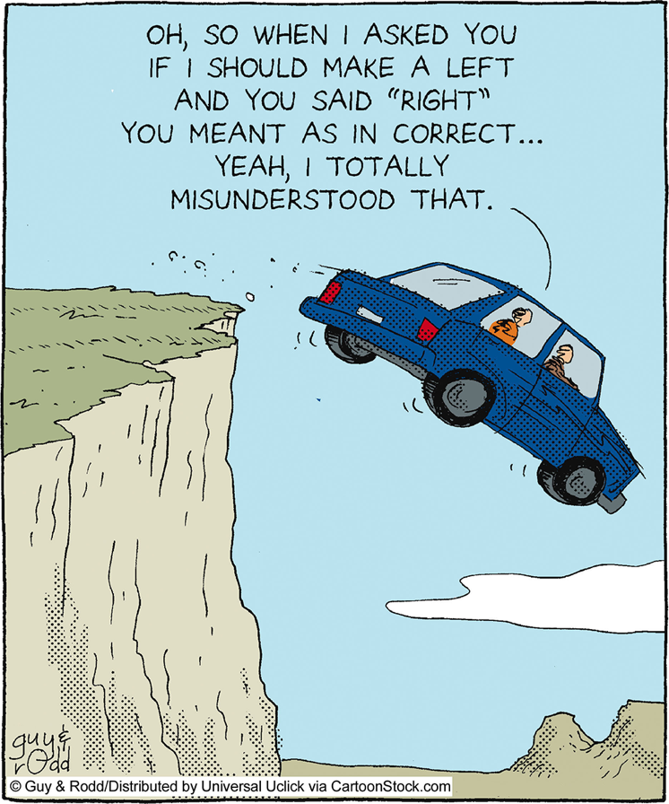
Policy is a great place to start
Notes:
Key message: One great way to start is by establishing an asset management policy.
Notes: While any first step is a good one, policy is a great place to start.
Why does having a policy matter? Sound asset management practices start with good, clear policies.
The word politician means “policy setter.” Council’s main job is to provide clear, broad direction through policy. Staff’s job is to work out the details. With policy in place, we can ensure that the asset management process is the lens through which we make all of our decisions. In the absence of a policy, staff are forced to guess what we, as council, want. Policy sets direction and eliminates guesswork.
If you are short on time, you may choose to omit this slide.

Slide 35
Actions we can take right now:
Policy
Resolution from council
Engagement
Life cycle costing
…so what do we want to do?
Notes:
Key message: Any first step is a good first step!
Notes: Here are some actions we can take right now:
Policy: Direct staff to develop some policy options to bring back to council.
Resolution from council: Direct staff to start exploring asset management practices.
Engagement: Dialogue with staff to determine where the organization is in the data-gathering process.
Life cycle costing: Commit to using full life cycle cost accounting in our decision-making. This means taking into consideration all the costs incurred throughout the whole life of an asset, such as planning, capital, operations, preventative maintenance, renewal and disposal costs.
Any first step is a good first step!

Slide 36
Let’s not pass it on
Notes:
Key message: The sooner you start embracing asset management as a way of doing business, the easier it will be to move toward a more sustainable future.
Notes: By embracing sound asset management practices, council can get the information we need to make great decisions. When we work with staff, together we can ensure that our residents receive the sustained, cost-effective services they expect. Staff need resources to get asset management practices up and running. How will we support them?
The intention of this session was to raise our collective understanding of asset management. The question we need to ask ourselves is this: What steps should we take to ensure we can provide sustainable services into the future?
If you are short on time, you may choose to omit this slide.

Slide 37
Let’s discuss asset management in our community
What are the most important services that we deliver to our citizens?
Do we have the information we need to ensure that we can continue to provide these services over the long term?
Do we know which assets provide these services? What condition those assets are in? When they will need to be repaired and replaced? And how much it will cost over the long term to continue providing these services?
Which of our services do we consider CRITICAL (i.e., must not fail or it would have a significant impact to the health, safety or quality of life of our citizens)?
Are we investing enough in our assets to ensure our most critical services can be sustained? How do we know?
What can we do to ensure we can answer these questions and feel like we have the right information to be responsible stewards of our community’s services?
Notes:
These questions are designed to get your council thinking and talking about the services your municipality currently provides, what information it has and what information it might need to make great infrastructure-related decisions.
We encourage you to introduce them at the end of your presentation, or throughout your session, in whatever way you feel will be most effective in creating an engaged discussion.
If you’re using this presentation in a formal council meeting, you may choose to discuss these questions as a group.
If you’re presenting to council in a less formal setting, you may wish to have members discuss these questions in small groups. One facilitation option is to post each of these four questions on a flip chart around the room. Have groups of 2-4 council members start at each question station and write their notes on the flip chart. Ask the groups to rotate after 3-5 minutes, so that each group has the opportunity to contribute notes to each question. If there is time, have someone summarize the main points captured under each question in plenary.

Slide 38
Thank you!
This presentation was developed through the Municipal Asset Management Program, which is delivered by the Federation of Canadian Municipalities and funded by the Government of Canada.

